Slide 1
Iteration 1
Team 6:
Hannah Nguyen
Puskar Dev
Safi Ullah

Slide 2
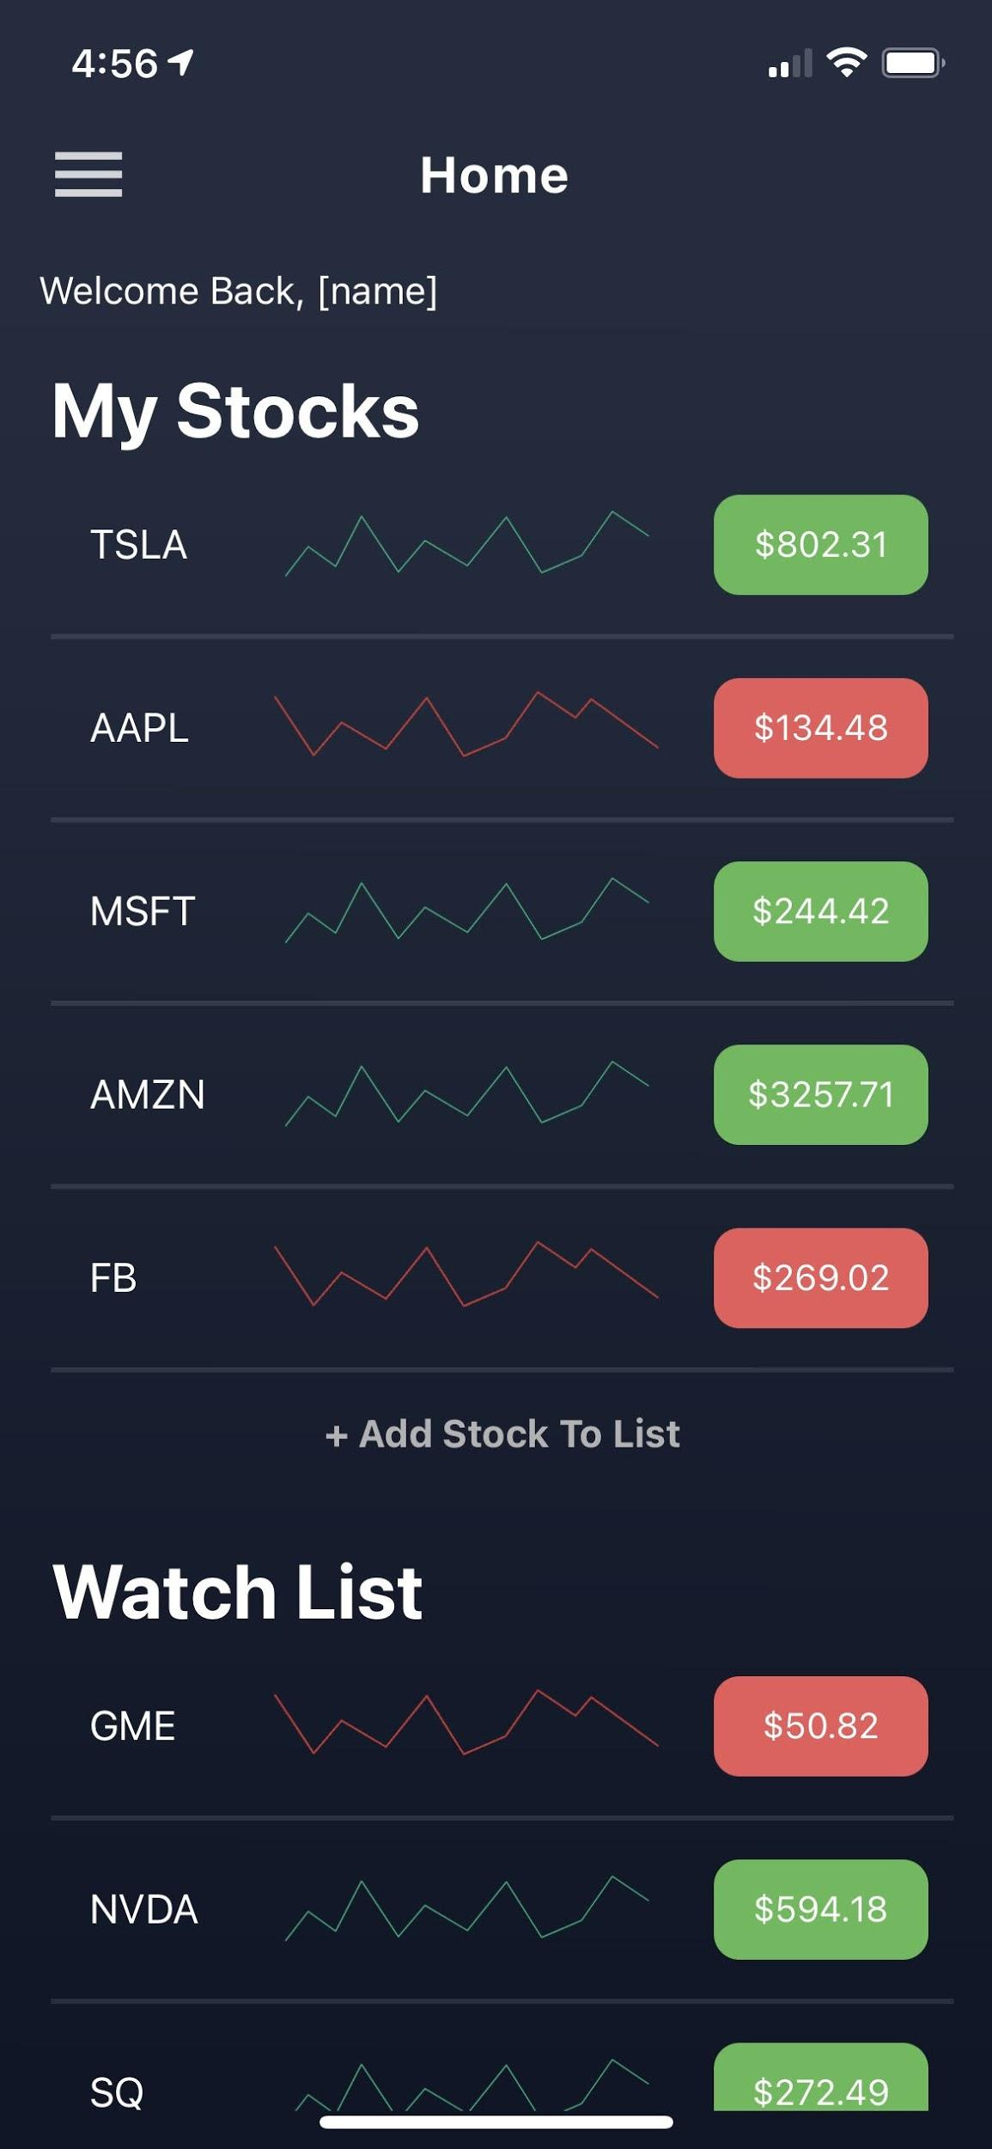
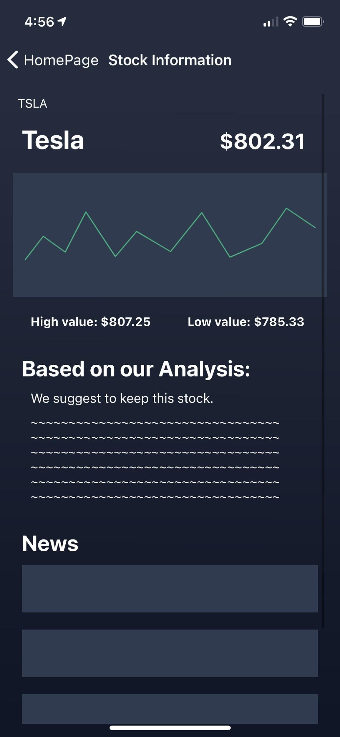
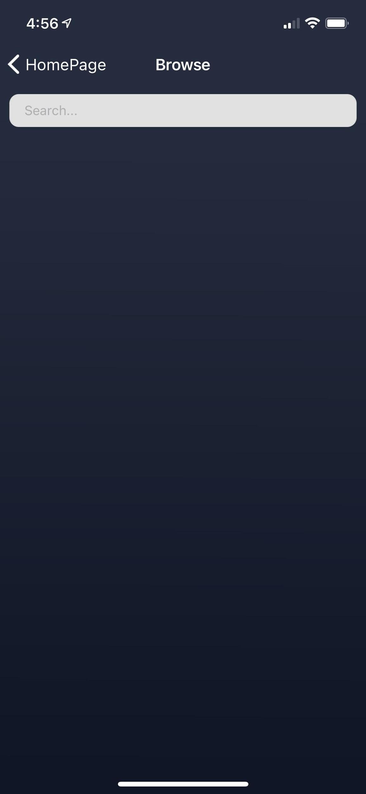
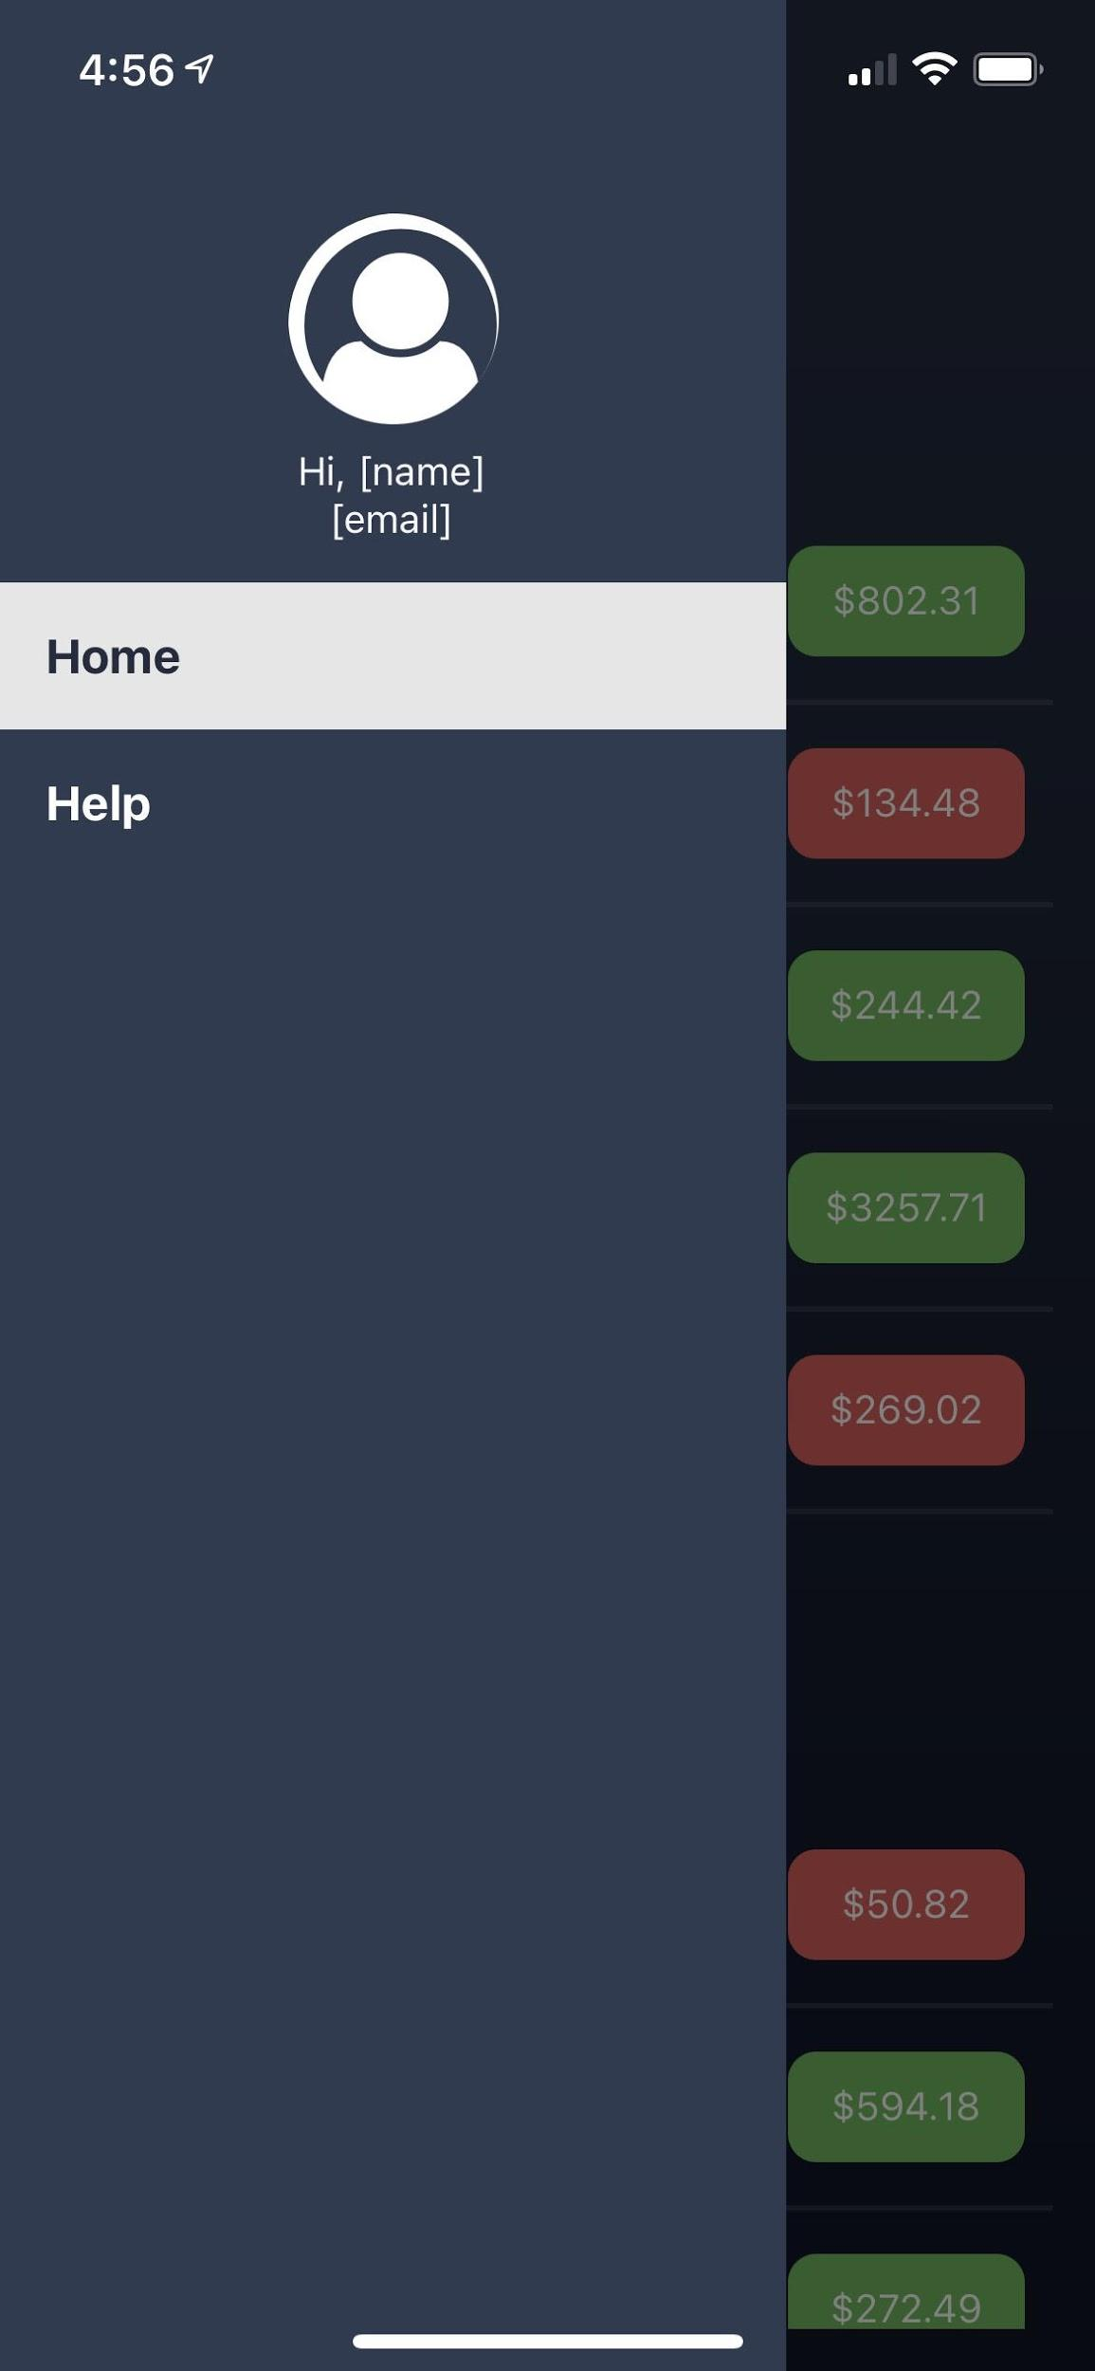
1
UI Screenshots

Slide 3
2
Sentiment Analysis on Tweets
Twitter API to collect tweets for a given stock
API response contains three fields: tweet id, created date and time, and text of the tweet
Text in tweet may contain unnecessary info such as excessive whitespaces, web addresses and name of twitter users
Regular expressions to clean the tweet

Slide 4
3
Sentiment Analysis on Tweets
Flair library on Python to run sentiment analysis on the cleaned tweets.
Flair is a Natural Language Processing Library (NLP) library that uses keras tensorflow and pytorch . It has a pre-trained sentiment analysis model.
The prediction results: a score (i.e. confidence/probability) and a value as (NEGATIVE/POSITIVE) for the a tweet’s text.

Slide 5
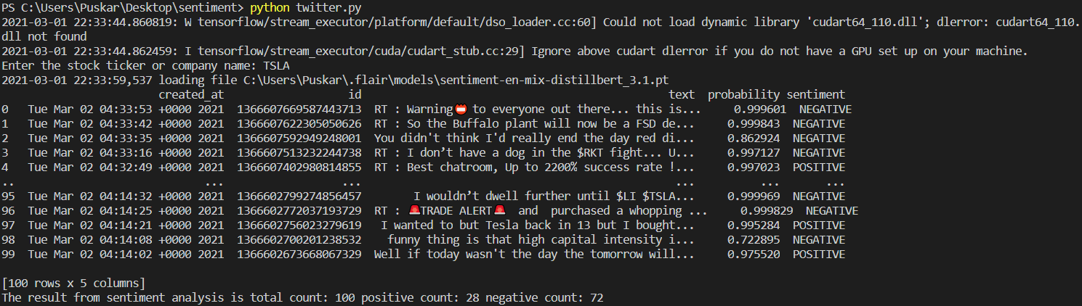
4

Slide 6

5
WHY does it matter?
Various studies and some research shows that public opinion or human emotions can have impact on volatility of stock market.
Example, a research paper ‘Twitter mood predicts the stock market.’ by Bollen et.al, proved that there is a correlation between the moods of public expressed on twitter and the way stock market performs.
Notes:
Research paper found here:
https://arxiv.org/pdf/1010.3003.pdf
image link;
https://paperswithcode.com/paper/sentiment-analysis-of-twitter-data-for

Slide 7

6
Challenges
Learning React Native
Accessing large number of tweets

Slide 8

7
Future development plans
Set up database to store info
Create login page
Have a user agreement contract
Connect front-end with the back-end

Slide 9
Github Link
8
https://github.com/puskardev/StockApp

Slide 10
THANKS!
Does anyone have any questions?

